Slide 1
WPMayor
The Story, The Works
Presented by Jean Galea

Slide 2

Where I come from…

Slide 3
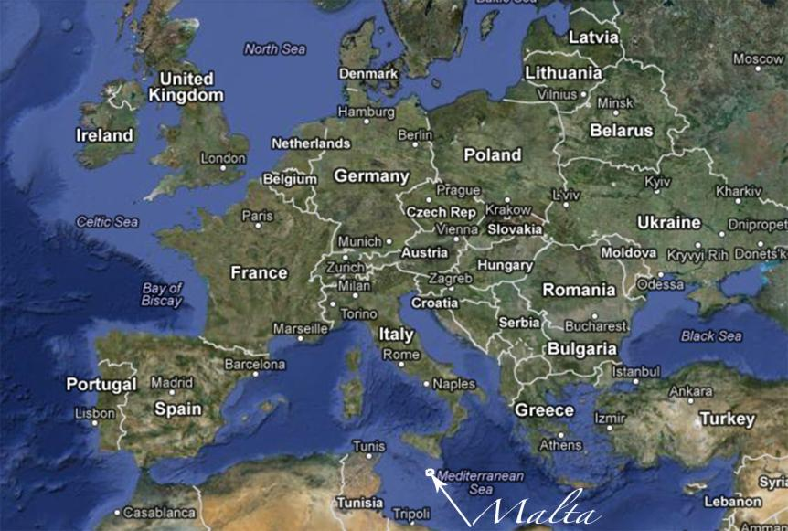

Slide 4
Jean Galea
WordPress developer
Blogger
Site: www.wpmayor.com
Twitter: @wpmayor

Slide 5
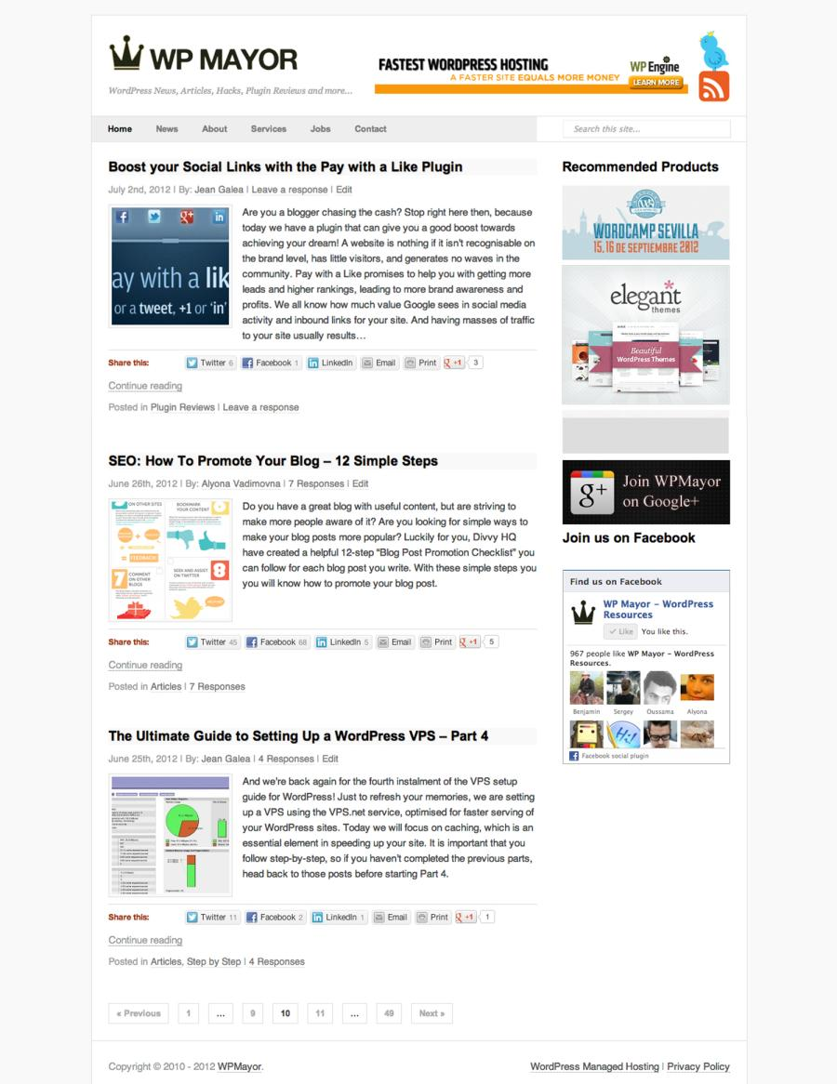
WPMayor.com

Slide 6
The Story

Slide 7
The Story
Started late 2010
A place to post ideas and research
Inspired by others
  WPCandy
  WPRecipes
  WPMU
Built on the ‘Prototype’ theme in a few hours

Slide 8
Growing the site
SEO techniques
Guest writers
Commenting on other blogs
Interviewing other WordPress developers
Social networks (Twitter, Facebook, Linkedin)
RSS via Feedburner
Competitions (Rafflecopter)

Slide 9
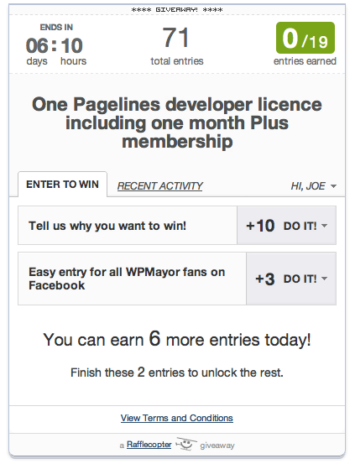

Slide 10
Planned Improvements
Better branding
New theme (responsive)
More article styles
Better site navigation
Growing the mailing list
Email newsletter

Slide 11


Slide 12
What I learnt about Blogging
Focus on content
Leverage social networks
Engage visitors
Brand your site
Provide good navigation
Innovate constantly

Slide 13
The Works

Slide 14
Themes
The ideal theme
  Appropriate design for your content
  Well supported and updated
  Clean, good code
Free or Premium?
Responsive

Slide 15
Themes – Recommendations
Pagelines theme builder
Genesis theme (used by many big blogs like Yoast)
Woothemes
Elegant Themes
Theme Hybrid
Themeforest (quality can vary)

Slide 16
Hosting
Three major types
  Shared
  VPS
  WordPress managed

Slide 17
Hosting – Recommended Hosts
Shared hosting
  Hostnine
  Hostgator
  Bluehost
Virtual Private Servers
  VPS.net
  Linode
  Slicehost
WordPress Managed Hosting
  WP Engine
  Page.ly

Slide 18

Plugins - Recommendations
SEO – WordPress SEO (Free)

Slide 19

Plugins - Recommendations
Speed/Caching – W3 Total Cache (Free)

Slide 20
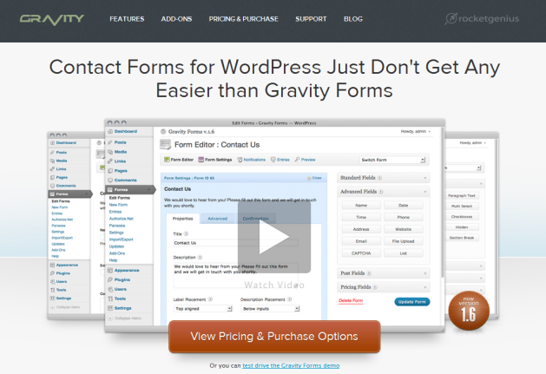
Plugins - Recommendations
Forms – Gravity Forms (Premium)

Slide 21

Plugins - Recommendations
Related Content – nRelate (Free)

Slide 22

Plugins - Recommendations
Capturing Emails – Pippity Popups (Premium)

Slide 23

Plugins - Recommendations
Email Newsletters – WYSIJA (Freemium)

Slide 24

Plugins - Recommendations
News Aggregation – WP RSS Aggregator (Free)

Slide 25

Plugins - Recommendations
Backups - BackupBuddy (Premium)

Slide 26
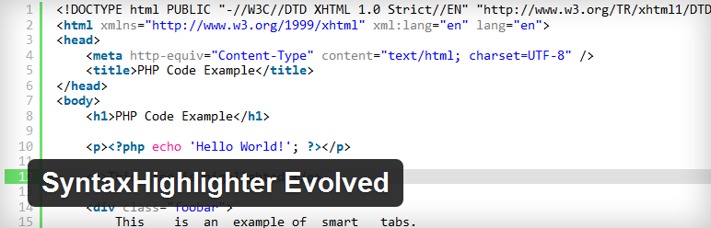
Plugins - Recommendations
Code Formatting – SyntaxHighlighter Evolved (Free)

Slide 27
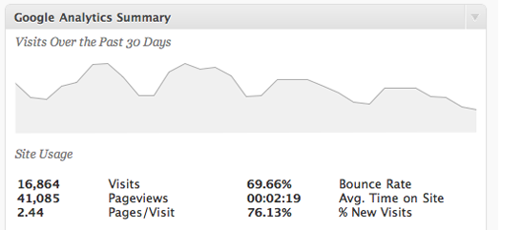
Plugins - Recommendations
Analytics – Google Analyticator (Free)

Slide 28
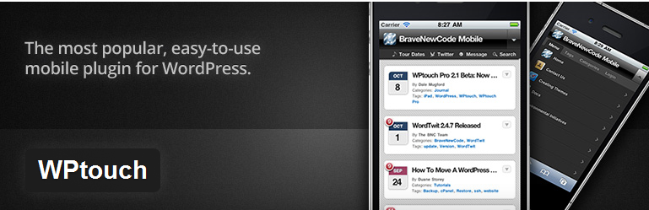
Plugins - Recommendations
Mobile – WP Touch (Freemium)

Slide 29
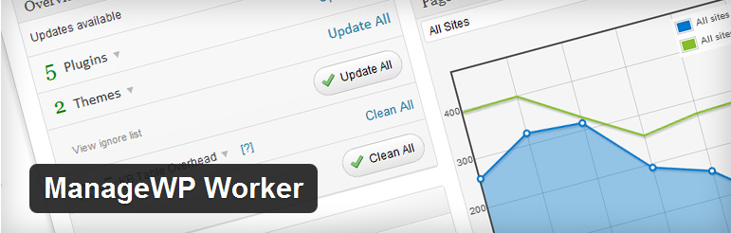
Plugins - Recommendations
Management – ManageWP (Premium)

Slide 30

Plugins - Recommendations
Multilanguage – WPML (Premium)

Slide 31
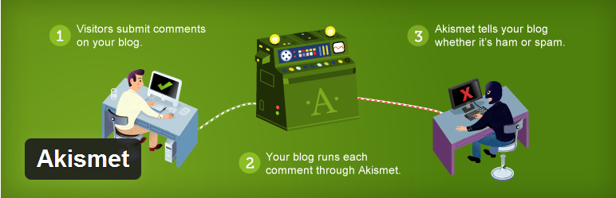
Plugins - Recommendations
Spam Filter – Akismet (Free)

Slide 32

Plugins - Recommendations
Facebook - Facebook Page Publish (Free)

Slide 33

Plugins - Recommendations
Twitter – WP to Twitter (Free)

Slide 34

Plugins - Recommendations
Sharing icons & statistics – Jetpack (Free)

Slide 35
Questions?
WPMayor
www.wpmayor.com
@wpmayor

